Slide 1
Software Engineering Concepts (CSC205)
Lecture 8

Slide 2
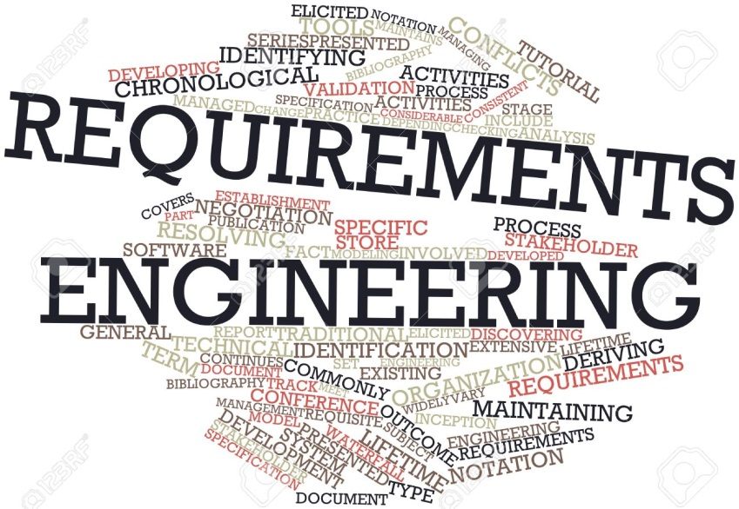
Topics
Requirement Engineering
Type of Requirements
Functional vs. Non-Functional Requirements
Requirement Discovery Techniques

Slide 3
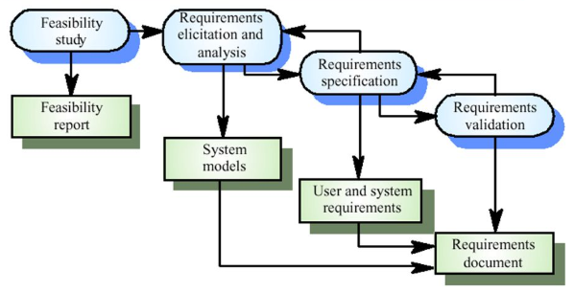
RE: Process…

Slide 4
Functional vs. Non-Functional Requirements
Functional Requirements (FRs)
FRs mention What the system should do?
Features
E.g.,
When a customer registers on CUI website
Send an email
Non-Functional Requirements (FRs)
Constraints on how the system should do it.
Quality
E.g.,
Email must be sent 2 sec after the customer registration

Slide 5
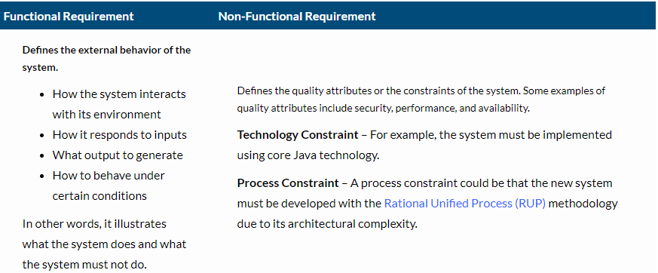
FRs vs. NFRs…

Slide 6
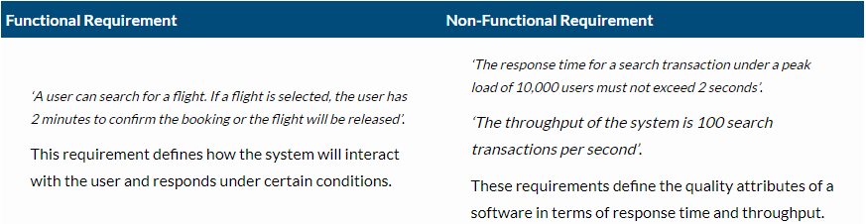
FRs vs. NFRs…
Let us consider an example of an airline reservation system, where users can search and book flight tickets. The Functional and Non-functional requirements for this use case can be defined as:

Slide 7
Functional Requirements: Mental care System
A user shall be able to search the appointments lists for all clinics.
The system shall generate each day, for each clinic, a list of patients who are expected to attend appointments that day.
Each staff member using the system shall be uniquely identified by his or her 8-digit employee number.

Slide 8
Metrics for Specifying Non-Functional Requirements
Property | Measure
Speed | Processed transactions/second User/event response time Screen refresh time
Size | Mbytes Number of ROM chips
Ease of use | Training time Number of help frames
Reliability | Mean time to failure Probability of unavailability Rate of failure occurrence Availability
Robustness | Time to restart after failure Percentage of events causing failure Probability of data corruption on failure
Portability | Percentage of target dependent statements Number of target systems

Slide 9
Hospital System: FRs and NFRs?
Functional Requirements:
Registration and admission of patients
Management of patient data including medical history and diagnosis
Scheduling and management of appointments with doctors, nurses, and other medical staff
Ordering and management of laboratory and diagnostic tests
Management of medication orders and administration
Generation of electronic prescriptions
Tracking of patient progress and outcomes
Integration with insurance providers and billing systems
Facilitation of referrals and transfers between medical facilities
Management of medical equipment and inventory
Creation and management of medical reports and documents
Maintenance of patient confidentiality and security
Non-functional Requirements:
Usability and user interface design
Performance and responsiveness
Security and privacy of patient data
Reliability and availability
Scalability to handle increasing patient volumes
Compatibility with existing hospital systems and third-party applications
Compliance with regulatory and legal requirements
Availability of technical support and maintenance services
Integration with medical devices and sensors
Accessibility for users with disabilities

Slide 10
User vs. System Requirements
User requirements
Statements in natural language plus diagrams of the services the system provides and its operational constraints. Written for customers.
System requirements
A structured document setting out detailed descriptions of the system’s functions, services and operational constraints. Defines what should be implemented so may be part of a contract between client and contractor.

Slide 11
User vs. System Requirements: Example

Slide 12
Eliciting Requirements
Requirements elicitation (also called requirements gathering ) combines elements of problem solving, elaboration, negotiation, and specification.

Slide 13
Eliciting Requirements: (1) Collaborative Requirements Gathering
Many different approaches to collaborative requirements gathering have been proposed. Each makes use of a slightly different scenario, but all apply some variation on the following basic guidelines:
Meetings (either real or virtual) are conducted and attended by both software engineers and other stakeholders.
Rules for preparation and participation are established.
An agenda is suggested that is formal enough to cover all important points but informal enough to encourage the free flow of ideas.

Slide 14
Eliciting Requirements: (1) Collaborative Requirements Gathering (cont..)
A “facilitator” (can be a customer, a developer, or an outsider) controls the meeting.
A “definition mechanism” (can be work sheets, flip charts, or wall stickers or an electronic bulletin board, chat room, or virtual forum) is used.
The goal is to identify the problem, propose elements of the solution, negotiate different approaches, and specify a preliminary set of solution requirements.

Slide 15
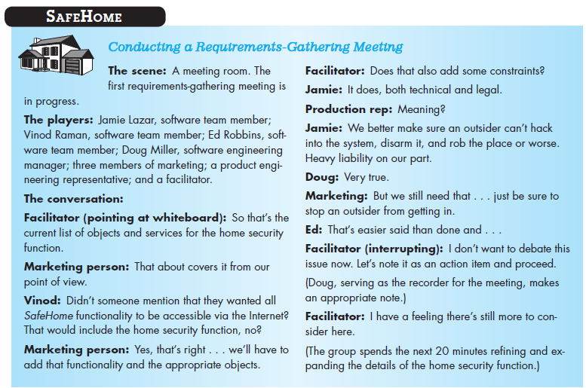

Slide 16
Eliciting Requirements: (2) Usage Scenario
As requirements are gathered, an overall vision of system functions and features begin to materialize.
However, it is difficult to move into more technical software engineering activities until you understand how these functions and features will be used by different classes of end users.
To accomplish this, developers and users can create a set of scenarios that identify a thread of usage for the system to be constructed.

Slide 17
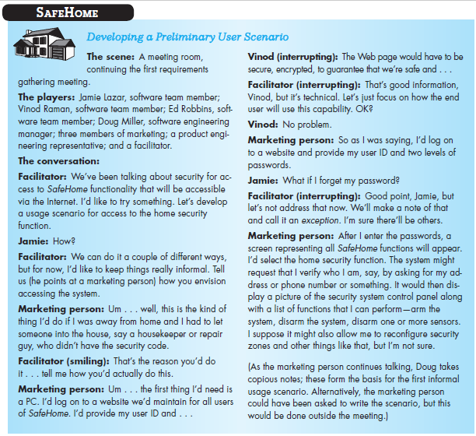

Slide 18
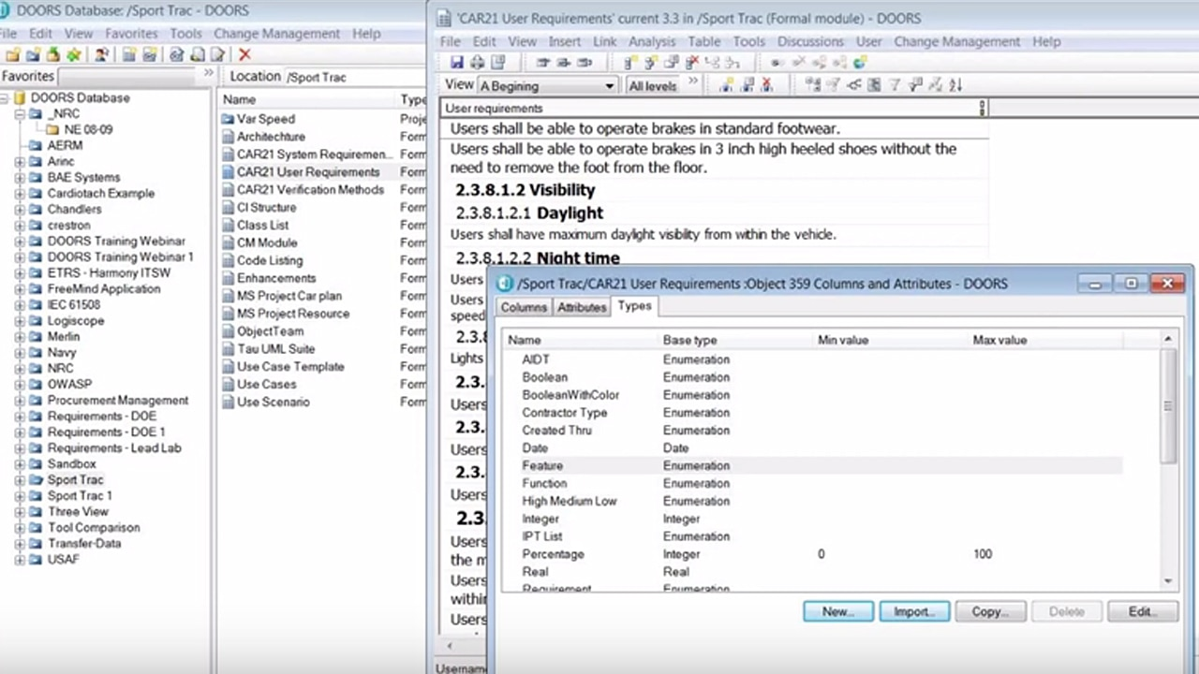
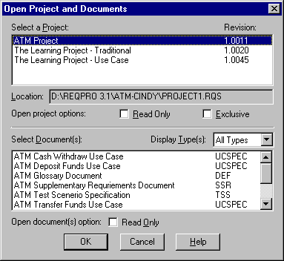
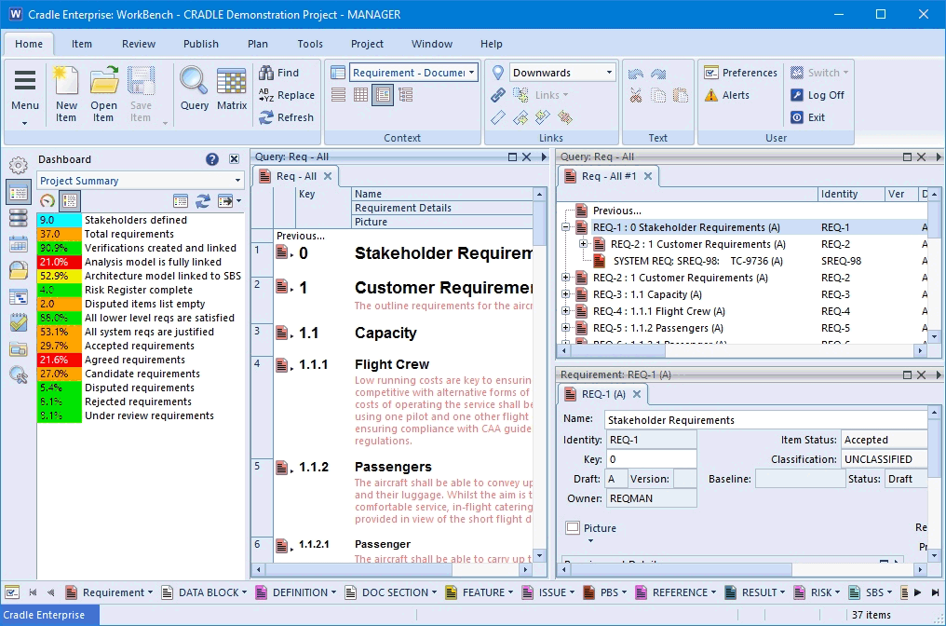
Automated tools for Req’s Management
Rational DOORs
Requisite Pro
Cradle

Slide 19
